Slide 1
SIT374: Project Management
Lecture 2: Project Initiating

Slide 2
Project process management groups - Initiation
Approved Project Management Plan
Completion Report
Monitoring
Initiation
Planning
Executing
Closing
Control
Approved Project Charter
Customer signoff

Slide 3
Management process – Activity Map
Project Plan
Acquire & manage
team
Monitor &
Control Proj.
Project
Closing
Project Charter
Scope
Time
Cost
Quality
HR
Risk
Procurement
Stakeholders
Comm.
Stakeholders
Register
Scope control &
verification
Select Sellers &
POs
Schedule/
Cost/risk control
Contract
Closing
☺
Progress Reporting
Perform QA
Manage Stakeholders
Comm.
Contract Admin
Initiation
Planning
Executing
Mon. & Con.
Closing

Slide 4
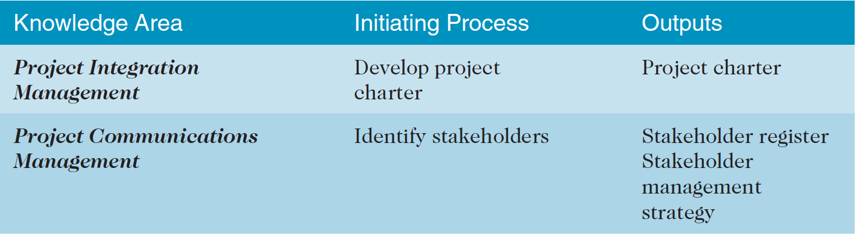
PROJECT Initiation
To officially initiate a project, the main tasks are to identify all stakeholders and develop the project charter.

Slide 5
PROJECT CHARTER
Project charter: a document that formally recognizes the existence of a project and provides direction on the project’s objectives and management.
It authorizes project manager to use organization’s resources to complete the project.
A Project Charter is created at the beginning of a project, approved by the stakeholders, and signed off before work can begin.

Slide 6
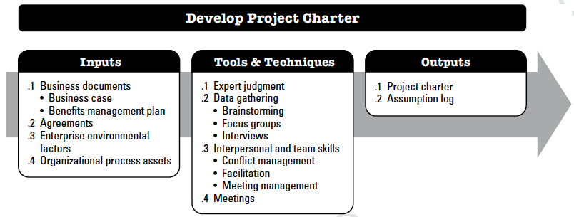
1. Develop Project Charter

Slide 7
Business case
A document that most commonly used to create project charter
It could be created from market demand, organizational need, customer request, etc.
It is used to justify and create boundaries for the project.
Financial (cost-benefit) analysis would be carried out to facilitate decision-making.
Sample Business Cases

Slide 8
Financial considerations
Can compare projects based on
Net present value (NPV)
Return on Investment (RoI)
Payback analysis

Slide 9
Cost vs. Revenue vs. Profit
Cost is resources expended to achieve a goal
Revenue is the income from the normal business activities
Profit (net benefit) = Revenue (benefit) – Cost (expenditure) (To increase profit : Reduce cost or Increase revenue)
Return on Investment (RoI) = (Revenue – Cost) / Cost

Slide 10
Time-value-of-money
What is the relationship between $1 today and $1 tomorrow?
Is it worth the same 1$ today as 1$ tomorrow/yesterday?

Slide 11
Activity 1 - An example
A project that requires an initial investment of $10,000 and will generate cash inflows of $3,000 annually for 5 years.
While the sum of the cash inflows is greater than the initial investment (net benefit is positive), can we say the project is worthy of investment?

Slide 12
Present value (PV) and net present value (NPV)
Present Value (PV): all costs/benefits are calculated using today’s dollars
1$ received next year may only worth 0.9$ this year
Discount rate is introduced to account for this phenomenon
Net Present Value (NPV): all costs/benefits are calculated using today’s dollars and they are combined to get a net value
When net benefit (without considering the discount) is positive, the net benefit (with the discount) might be negative
The discount effect could affect decision-making in investment

Slide 13
Discount rate and discount factor
Discount rate: the annual percentage rate/percentage rate in (project) unit time that an amount of money is discounted to bring it to a present value
PV=(amount in the next time unit)/(1+discount rate)
Discount factor: the accumulation of discounts in the entire period based on the discount rate
PV=(amount in the future)*1/(1+discount rate)^{(number of time units)}
Discount factor

Slide 14
Back to the example
A project that requires an initial investment of $10,000 and will generate cash inflows of $3,000 annually for 5 years.
What is the NPV if the discount rate for future cash flows is high (e.g., 20%)?

Slide 15
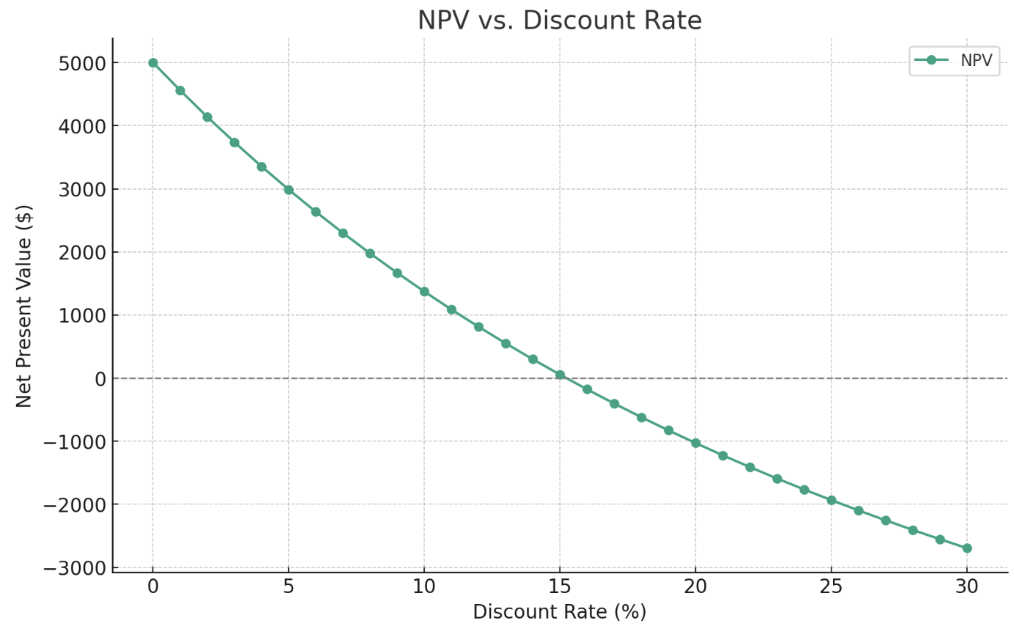
NPV vs. discount rate

Slide 16
NPV analysis
If… | It indicates… | Then…
NPV > 0 | the investment would add value to the firm | the project may be accepted
NPV < 0 | the investment would subtract value from the firm | the project should be rejected
NPV = 0 | the investment would neither gain nor lose value for the firm | indifferent in the decision This project adds no monetary value. Decision should be based on other criteria, e.g., strategic positioning or other factors not explicitly included in the calculation.

Slide 17
Return on investment (Roi)
RoI: it has become trivial to calculate RoI by incorporating discounts
RoI=(total discounted benefits-total discounted costs)/(total discounted costs
=NPV/total discounted costs
Can be used to compare different options
Organizations may have a minimum acceptable ROI for projects

Slide 18
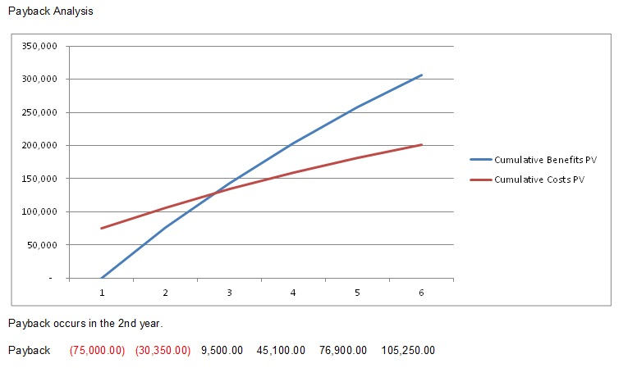
payback
Payback period: the amount of time it will take to recoup, in the form of net benefit.
Can be calculated based on either discounted or non-discounted analysis

Slide 19
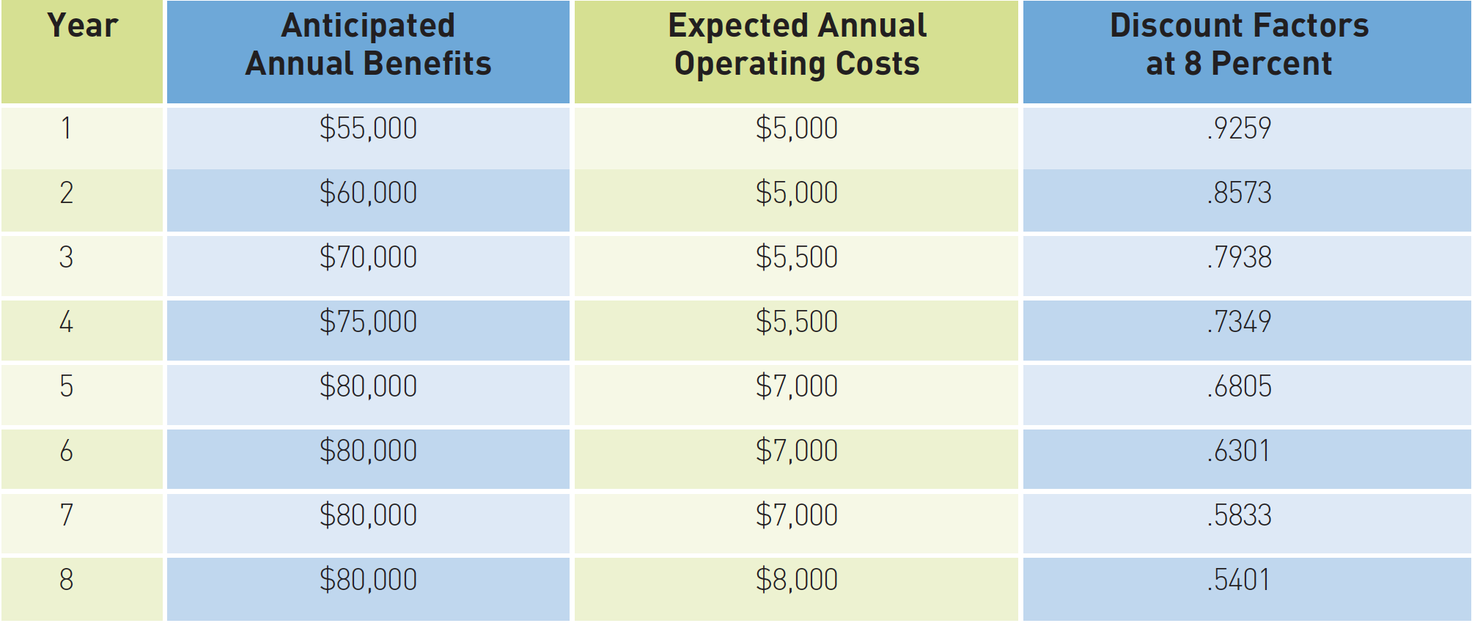
Activity 2
Calculate the net present value, and the return on investment using a discount rate of 8 percent for the following systems development project. The development costs for the system were $225,000

Slide 20
Organizational structure
3 basic organization structures
Functional: functional managers report to the CEO
Project: program managers report to the CEO
Matrix: middle ground between functional and project structures; personnel often report to two or more bosses; structure can be weak, balanced, or strong matrix

Slide 21
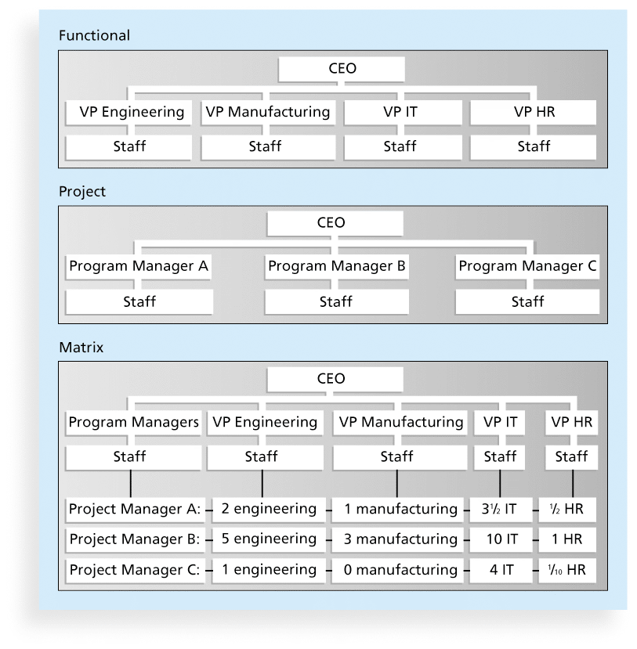
Organizational Structures

Slide 22
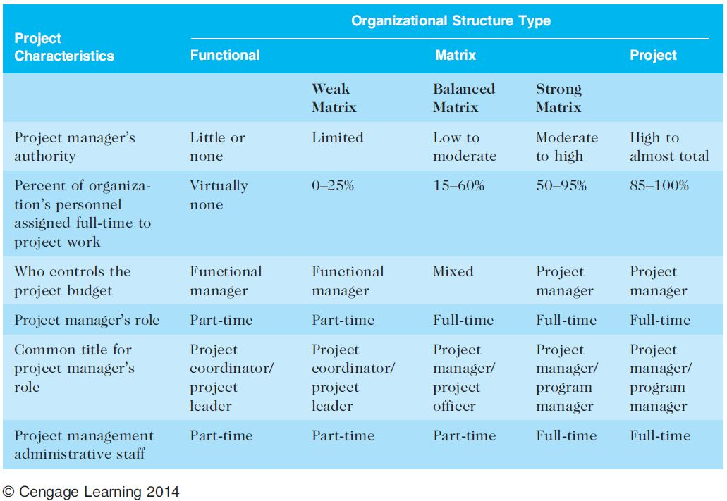
Impact of Organizational structure

Slide 23
Organizational process assets
Standard policies, processes, and procedures
Is there a standard process for developing and getting approval for a project charter?
Templates
Is there a standard format for project charters?
Historical information and lessons learned
Are there records for previous projects and documents?
Any information on previous project performance?

Slide 24
Project Charter – typical contents
Without the project charter, no project exists (PMPBOK)
Project Objective
Project Justification
Project Constraints
Project Risks
Stakeholders Commitment.
Your name
Sample Project Charter

Slide 25
Activity 3
Look into Sample Project Charter for IT System Update
What are the issues?

Slide 26
2. Develop Stakeholders Register
The successful completion of a project depends on satisfying your project stakeholders.
How to identify stakeholders?
Internal [Team, Employee, Owners]
External [Customers, Suppliers, Investors, Governments]

Slide 27
Activity 4
Who are the key stakeholders in Hope Health case study?

Slide 28
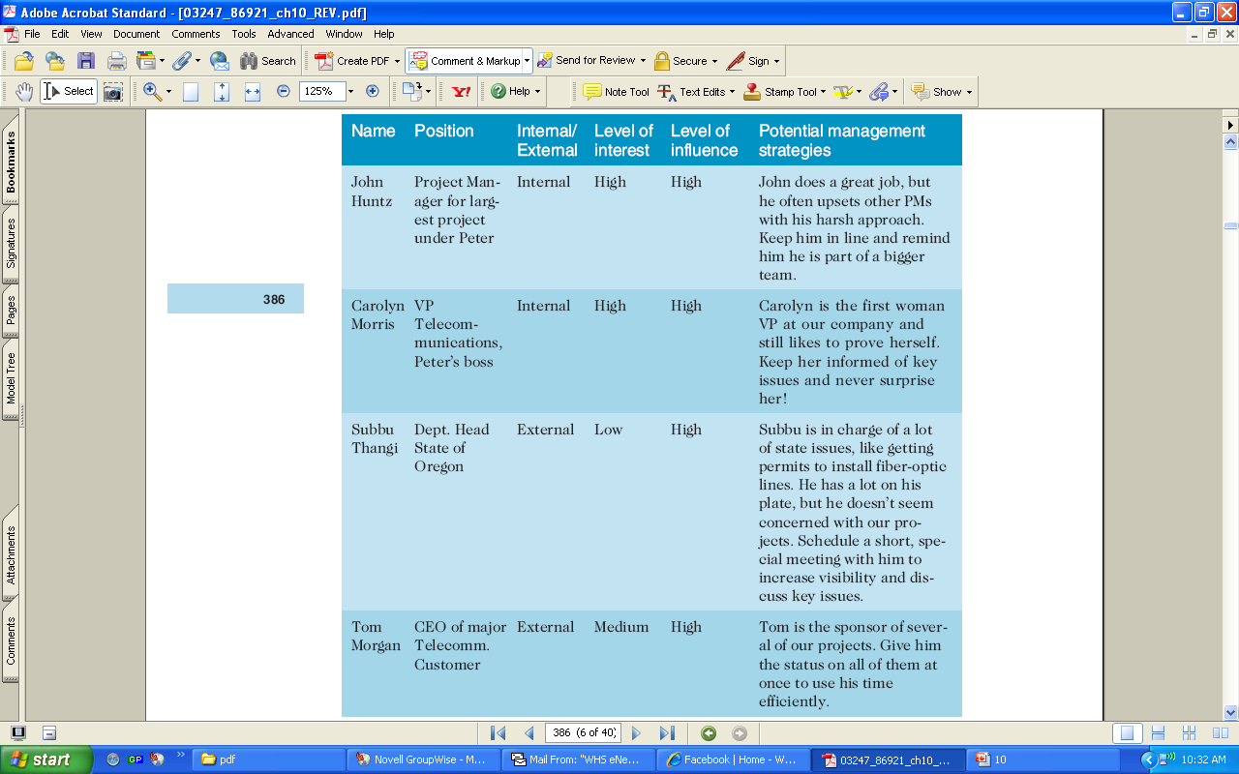
STAKEHOLDER REGISTER
Stakeholder Register - a public document that includes details related to the identified project stakeholders

Slide 29
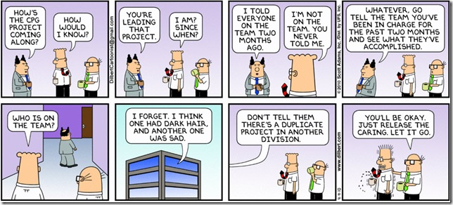
You have been appointed as the project manager, now what? ☺

Slide 30
Project process management groups - planning
Approved Project Management Plan
Completion Report
Monitoring
Initiation
Planning
Executing
Closing
Control
Approved Project Charter
Customer signoff

Slide 31
Project Management Plan
Completion of project initiation is the signal that the project has approval to proceed to planning.
A project management plan is a document used to coordinate all project planning documents and guide project execution.
Project Management Plan required - Integration of all other plans - information is required from all other knowledge areas.

Slide 32
Project Management Plan
Project Management Plan includes
The project name, description, sponsor’s name, description of the project, project organization
Major work packages (scope baseline): WBS, key products
Schedule information section (schedule baseline): Gantt Chart, Network Diagram (activities and dependencies)
Budget information section (cost baseline): Summary budget, Detailed budget
Subsidiary management plans: scope, schedule, cost management plans, etc.
Other sections: project life cycle description, development approach

Slide 33
Summary
Initiation input
Business case, organizational process assts, etc.
Financial analysis
Initiation activities
Develop project charter
Develop stakeholder register
Project management plan
Output of initiation process serves as input to planning
Planning result in project management plan

Slide 34
What’s next
Project planning - plan for scope, time, cost…

